Slide 1
Neural Networks

Slide 2
Cross-Entropy Loss Calculation
L=−[ylog(y’​)+(1−y)log(1−y’)]
where y – actual value, y’ – predicted value
For x = 3
y’ = 0.64, y = 0
L = −[0⋅log(0.64)+1⋅log(1−0.64)] = −log(0.36) = 0.444
Loss

Slide 3
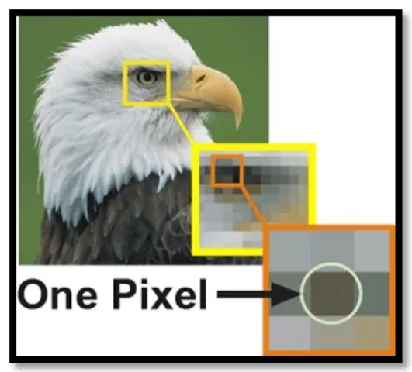
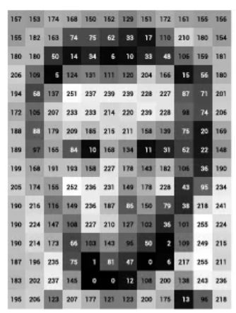
Convolutional Neural Networks (CNN)
CNNs are a specialized type of neural network designed to process and classify images.
Digital images are grids of tiny units called pixels.
Each pixel represents the smallest unit of an image and holds information about the color and intensity at that point.
In an RGB image, each pixel is composed of three values corresponding to the red, green, and blue (RGB) color channels.
In a grayscale image, each pixel carries a single value that represents the intensity of light at that point.

Slide 4
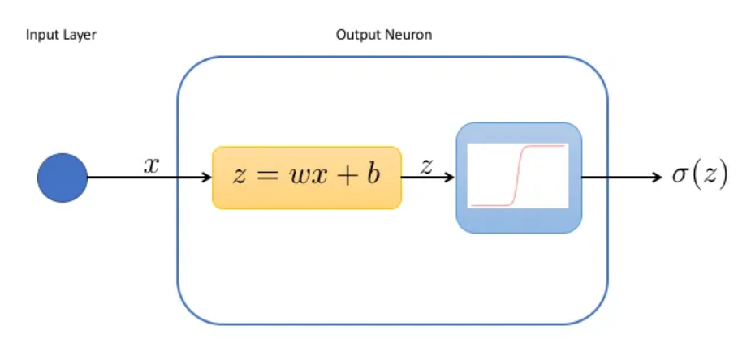
Basic Neural Network

Slide 5
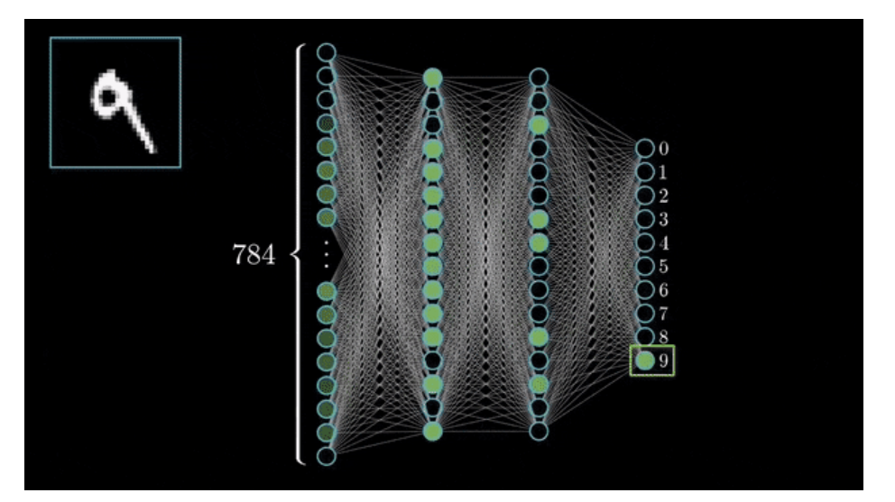
For example, in a classification task with digits from 0 to 9, the output layer would have 10 neurons.
Once a prediction is made, a loss is calculated and the weights are adjusted with backpropagation to reduce this error.

Slide 6
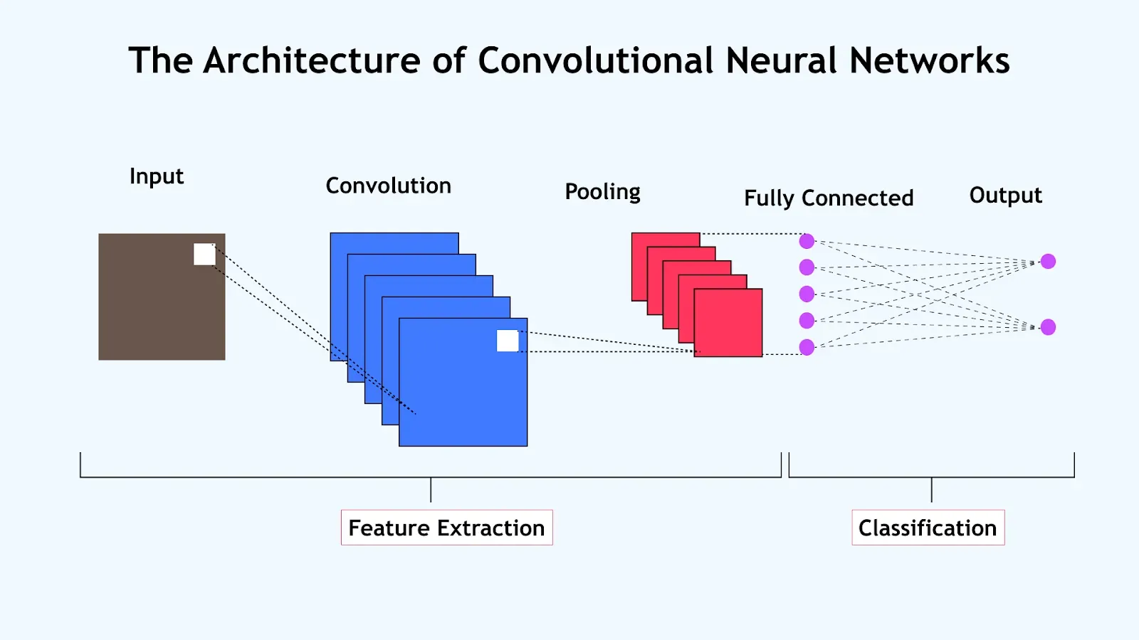
CNN architecture

Slide 7
CNN phases
Input Layer: image taken as input
Convolution Layer: apply filters to extract features
Activation function: adds non linearity, -ve values converted to 0
Pooling layer: reduces size of feature maps, keeps important information
Repeat steps 2 to 4
Flattening: convert 2D feature maps to 1D vector
Output layer: classification

Slide 8
Convolutional layers
CNNs employ a convolutional layer that perform a critical mathematical operation known as convolution.
It involves the application of specialized filters known as kernels, that traverse through the input image.
Kernels
Small matrices of numbers.
They move across the image performing element-wise multiplication with the part of the image they cover,
To extract features such as edges, textures, and shapes.
1 | 0
0 | -1

Slide 9
Convolution example
1 | 2 | 0 | 3
4 | 5 | 6 | 1
0 | 2 | 3 | 4
1 | 2 | 1 | 0
Input image
1 | 0
0 | -1
Kernel

Slide 10
CNN workflow
Convolution – detects features
ReLU – keeps important signals
Pooling – reduces size of feature map while preserving key features
Convolution → ReLU → Pooling (Repeated multiple times)
Layer 1: detects edges
Layer 2: detects shapes
Layer 3: detects objects

Slide 11
Filters (kernels) in convolution
Initially a kernel with random values is taken.
No useful feature may be detected
Network starts adjusting the weights and the kernel values over multiple iterations.

